Slide 1

Customer Segmentation and Behavior Analysis:
A Clustering Approach using Radar Charts and Scatter Plots
Notes:
Standard cleaning – looking for duplicates, addressing null values, converting formats, stripping extra spaces. Some feature engineering here like encoding gender, but more of that later when we got into clustering.

Slide 2
Demographics
Notes:
Biggest challenge was how to select/engineer features. For addresses, I determined what might be most valuable from postal code, city and state was the geographic location and size of the city. Replaced these variables with city population and latitude/longitude coordinates. In the end, my features were Income, age, years with bank, number of children, gender, marital status, city population, latitude and longitude.

Slide 3
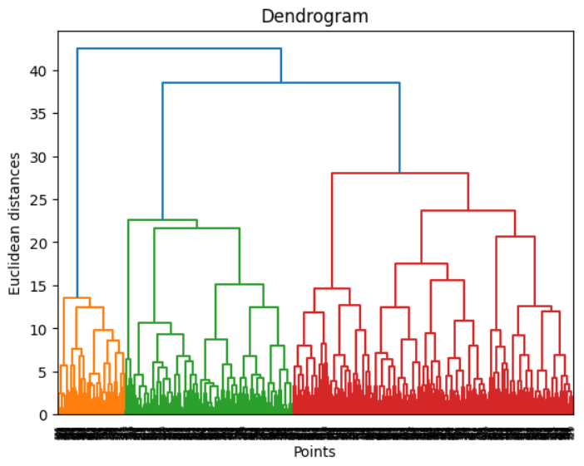
Dendrogram
Determining Optimal Number of Clusters

Slide 4
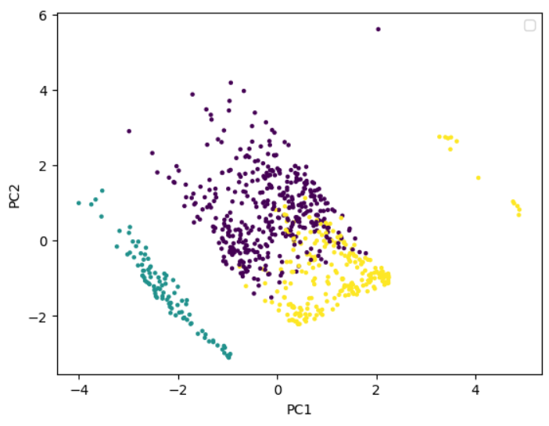
PCA Scatter Plot: Demographic Data Clusters

Slide 5
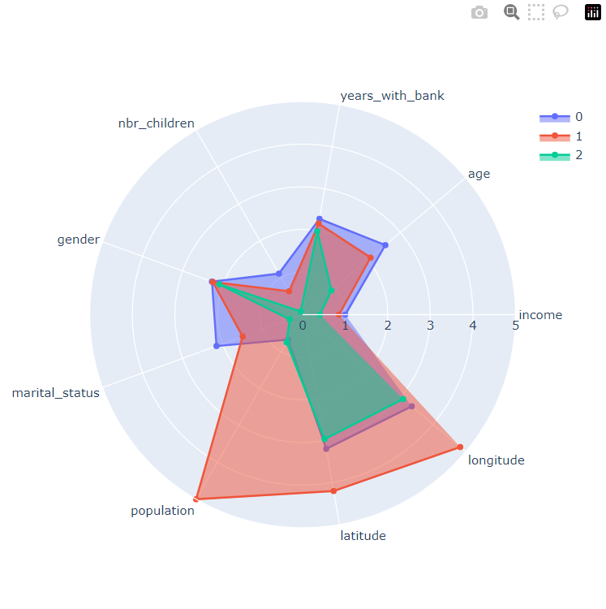
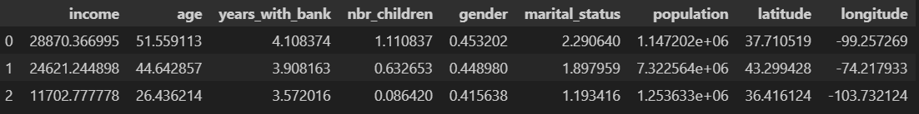
Radar Chart: Demographic Clusters Attributes
Notes:
One interesting thing to note when looking at consumers overall, is that despite different information from credit and savings accounts is that there is a clear divide between 3 classes of individuals based on their spending habits, alluding to a higher, middle and lower class. Those in cluster 0 and 1 appear to be spending within their means based on income and funds coming in. Those in cluster 2, as in severe debt and do not have enough money coming in to offset their spending habits.

Slide 6
Savings Transactions

Slide 7
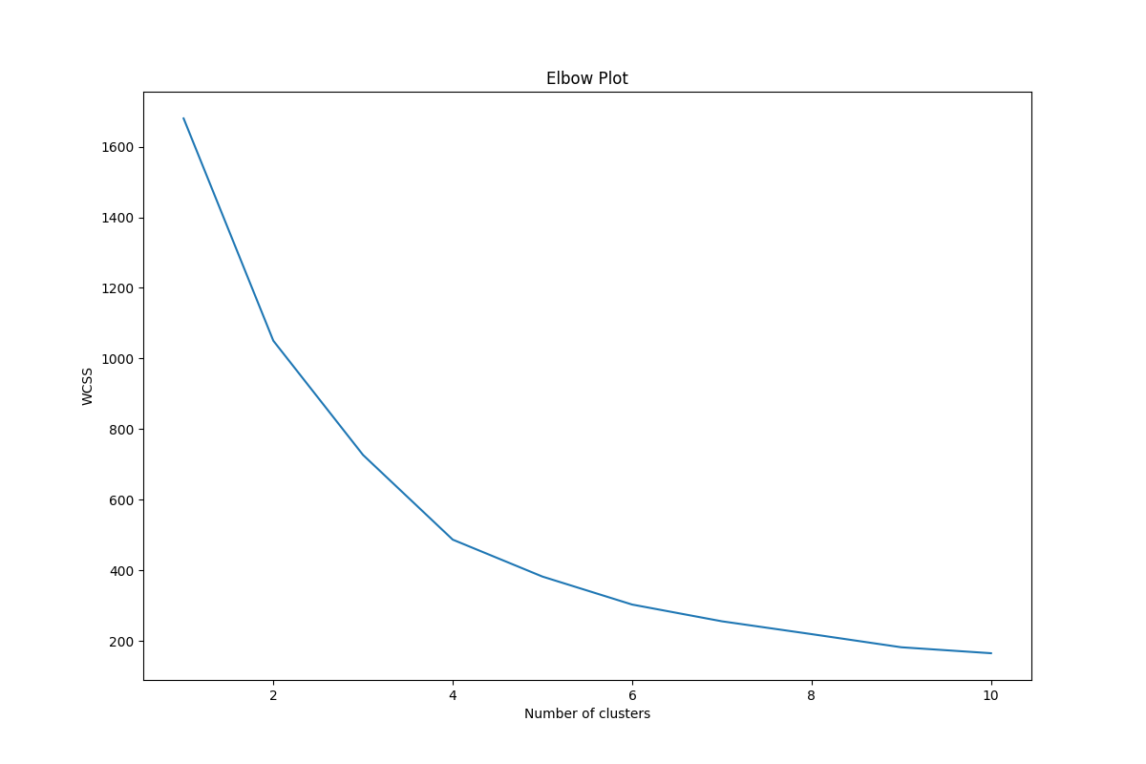
ELBOW PLOT: Determining Optimal Number of savings Clusters

Slide 8
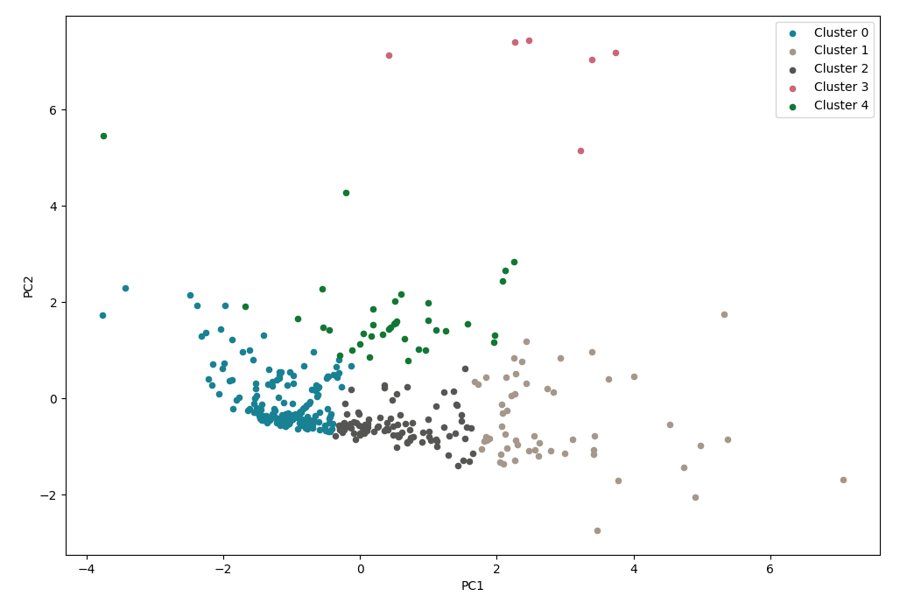
PCA Scatter Plot: Savings Data Clusters
Notes:
I removed 19 outliers from my data after first developing my clusters, as there was significant noise affecting the distribution and readability of data. Although they could be further studied, their removal improves the accuracy and reliability of the financial dataset by reducing the influence of noise and increasing the signal-to-noise ratio in the data.

Slide 9
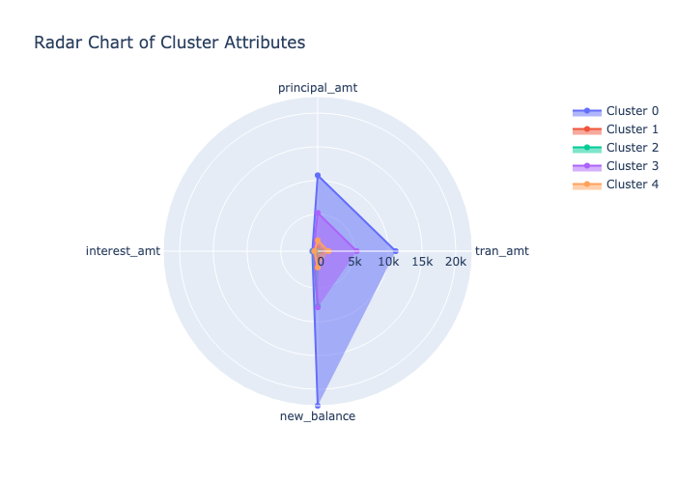
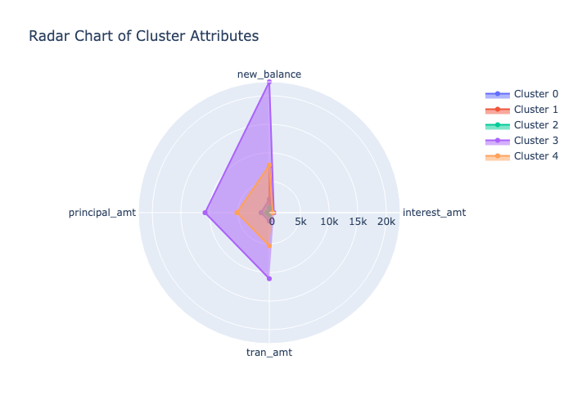
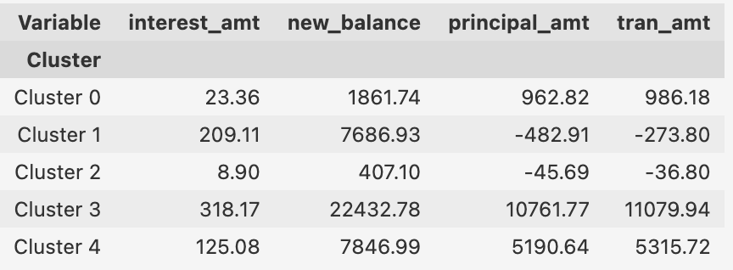
Radar Chart: Savings Clusters Attributes
Notes:
Cluster 0: Shows low interest on a growing balance, indicating active saving but in smaller amounts, suggesting lower income.
Cluster 1: Experiences high interest on a larger balance, but with negative principal and transaction amounts, indicating withdrawals and reduced savings. They likely have moderate income.
Cluster 2: Gains minimal interest on a decreasing balance, as they actively withdraw and spend money from this account.
Cluster 3: Achieves the highest interest on the largest balance, indicating significant savings. This cluster likely represents individuals with high income.
Cluster 4: Similar to cluster 1 in terms of high interest on a larger balance, but stands out due to significantly higher spending and transaction amounts. This implies slightly higher income.

Slide 10
Credit Transactions

Slide 11
ELBOW PLOT: Determining Optimal Number of CREDIT Clusters

Slide 12
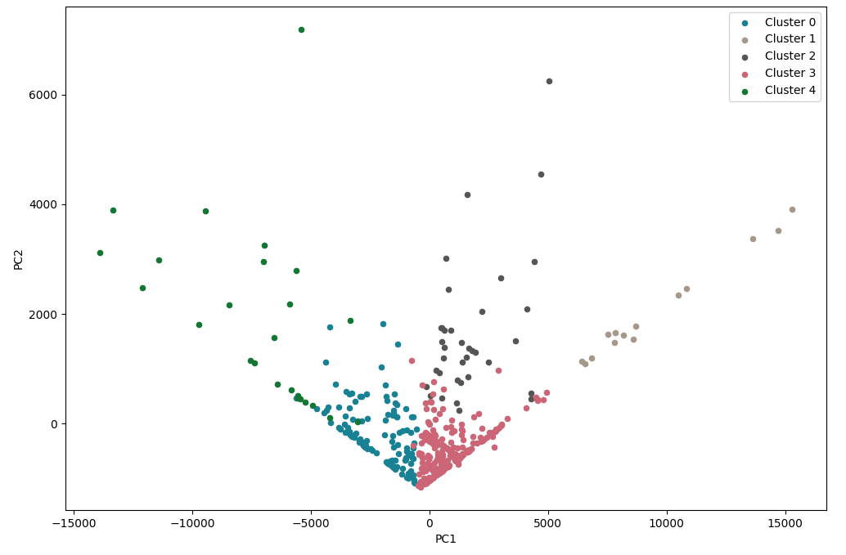
PCA Scatter Plot: CREDIT Data Clusters

Slide 13
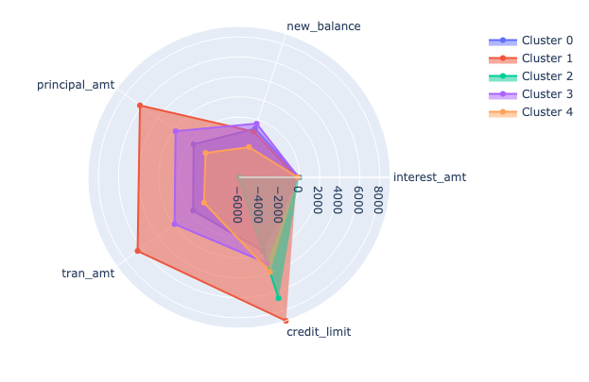
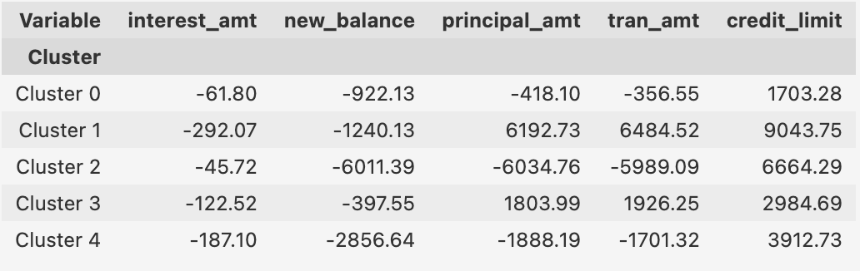
Radar Chart: CREDIT Clusters Attributes
Notes:
Cluster 0: Customers with lower credit limits have moderate credit card debt and tend to spend more than they pay off. This suggests they may be new to credit or have lower incomes, putting them at risk of accumulating debt.
Cluster 1: These customers have the highest credit limit and maintain the lowest negative balance, indicating responsible credit and debt management. They likely have higher credit scores and incomes.
Cluster 2: This cluster carries significant debt with high credit utilization. Their large principal, transaction amounts, and balance owed suggest recent major purchases or cash advances. It includes customers with lower incomes and recent financial difficulties.
Cluster 3: Despite a low balance owed, they have high transaction amounts, indicating frequent credit card use with regular payments. They have a lower credit limit but exhibit financial responsibility. This cluster likely represents the middle class.
Cluster 4: This cluster has a high balance owed, credit utilization, and interest levels, indicating substantial credit card debt and difficulty in paying off monthly expenses. While similar to cluster 2, they differ in spending capacity, with accumulating debt indicated by their interest. This cluster exhibits poor spending habits.

Slide 14
Overall Transactions

Slide 15
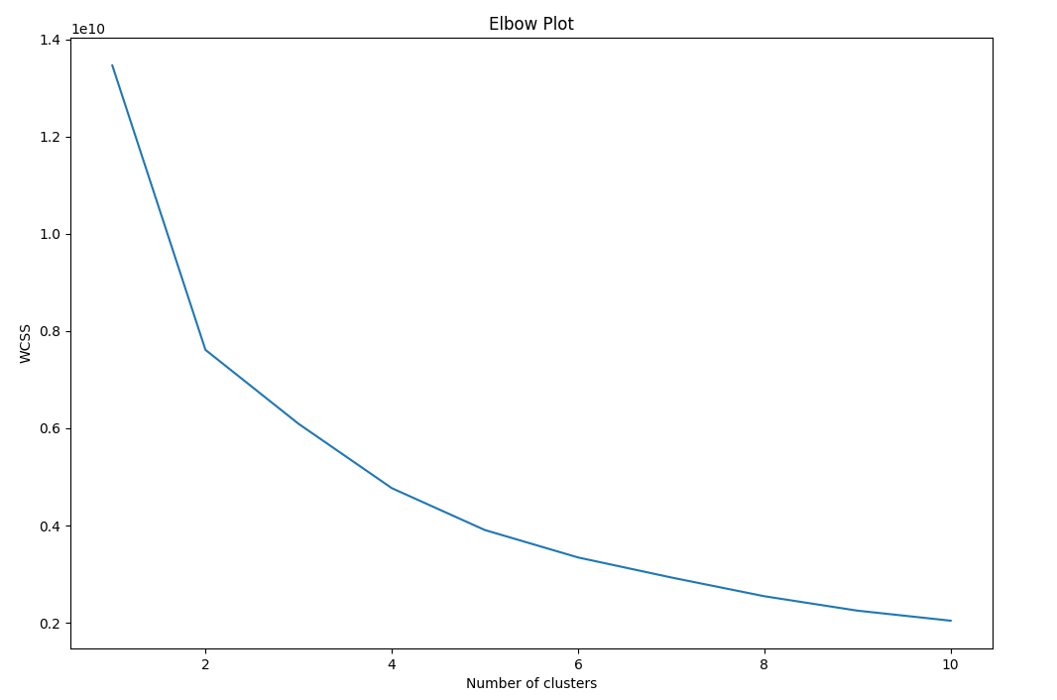
ELBOW PLOT: Determining Optimal Number of Transactions Clusters
Notes:
It appeared that 5 clusters was the better elbow point, but 3 clusters showed more distinct groups.

Slide 16
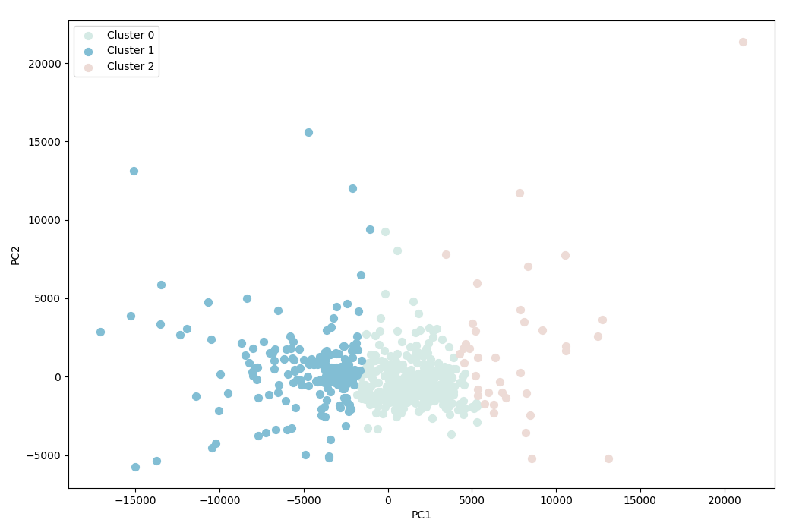
PCA Scatter Plot: Transactions Data Clusters

Slide 17
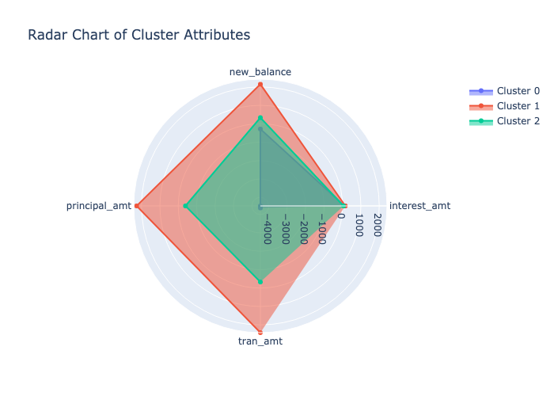

Radar Chart: Transactions Clusters Attributes
Notes:
One interesting thing to note when looking at consumers overall, is that despite different information from credit and savings accounts is that there is a clear divide between 3 classes of individuals based on their spending habits, alluding to a higher, middle and lower class. Those in cluster 0 and 1 appear to be spending within their means based on income and funds coming in. Those in cluster 2, as in severe debt and do not have enough money coming in to offset their spending habits.

Slide 18
Stretch

Slide 19
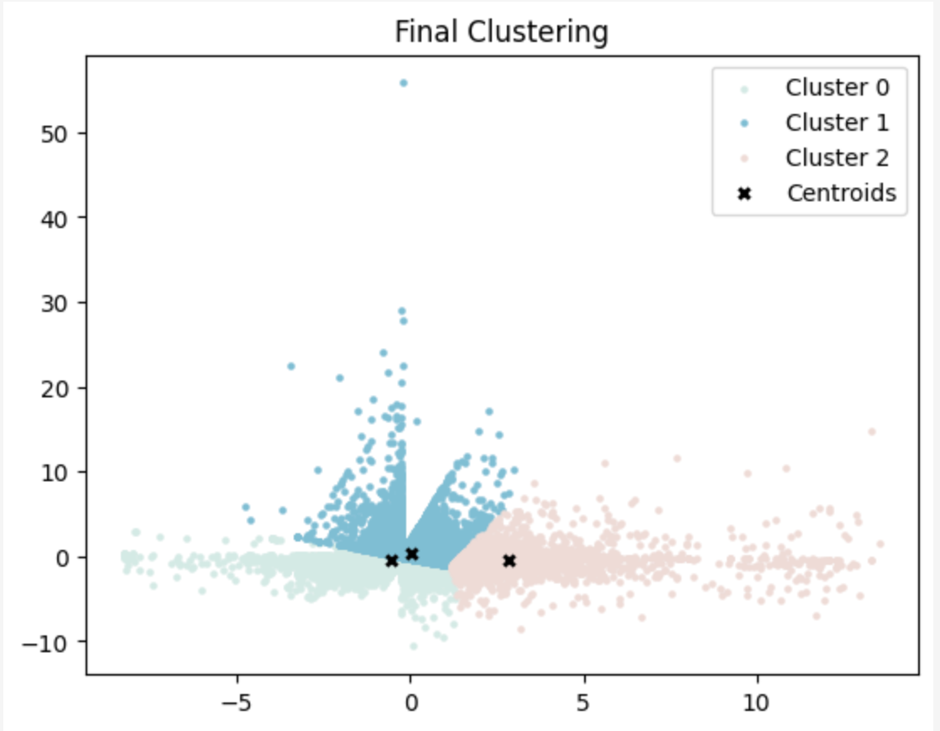
K-means Clustering with PCA and Visualization: (20 Iterations)
Notes:
We ran the transactions data again with PCA, but this time over 20 iterations to find the best fit for the centroids. This validated the earlier PCA and findings on transactions and once again showed a divide between three groups of people who appear upper, lower and middle class.

